Slide 1
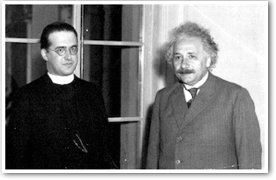
Science and Religion: The Myth of Conflict

Slide 2
MATERIALISM:
all reality is reducible to matter and its behavior

Slide 3
Carl Sagan: “I am a collection of water, calcium and organic molecules called Carl Sagan”
Francis Crick: “‘you,’ your joys and your sorrows, your memories and your ambitions, your sense of personal identity and free will, are in fact no more than the behavior of a vast assembly of nerve cells and their associated molecules. As Lewis Carroll’s Alice might have phrased it: ‘You’re nothing but a pack of neurons.’”

Slide 5
Philosophical argument:
Scientific outlook vs. Religious outlook
Historical argument:
Religion historically has been hostile to science and tried to suppress it
Scientific argument:
Discoveries since Copernicus Undermined Christian beliefs:

Slide 7
The heavens, as they revolve beneath his government,
do so in quiet submission to him. The day and the night run the course he has laid down for them … .
Sun, moon, and the starry choirs roll on in harmony at
his command, none swerving from its appointed orbit. ....
Laws of the same kind sustain the fathomless deeps of
the abyss and the untold regions of the netherworld. …
The impassable Ocean and all the worlds that lie beyond it are themselves ruled by the like ordinances of the Lord. …
Upon all of these the great Architect and Lord of the
universe has enjoined peace and harmony.
--- St. Clement of Rome (ca. 97 AD) (4th pope)

Slide 8
If, upon entering some home, you saw that
everything there was well-tended, neat, and decorative, you would believe that some
master was in charge of it, and that he was
himself much superior to those good things.
So too in the home of this world, when you
see providence, order, and law in the heavens
and on earth, believe that there is a Lord and
Author of the universe, more beautiful than
the stars themselves and the various parts of the whole world.
--- Minucius Felix (ca. 200 AD)

Slide 9
LAW LAWGIVER

Slide 10
“[Chinese scholars] had abandoned the idea of a supreme being with personal and creative properties. No rational Author of Nature existed in their universe; consequently the objects they meticulously described did not follow universal principles. … In the absence of a compelling need for the notion of general laws --- thoughts in the mind of God, so to speak --- little or no search was made for them.” (Edward O. Wilson)

Slide 12
MISCONCEPTION SHARED BY MOST ATHEISTS AND MANY CHRISTIANS
GOD versus NATURE

Slide 13
For all people who were ignorant of God were foolish by nature; and they were unable from the good things that are seen to know the one who exists, nor did they recognize the artisan while paying heed to his works; but they supposed that either fire or wind or swift air, or the circle of the stars, or turbulent water, or the luminaries of heaven were the gods that rule the world. If through delight in the beauty of these things people assumed them to be gods, let them know how much better than these is their Lord, for the author of beauty created them. And if people were amazed at their power and working, let them perceive from them how much more powerful is the one who formed them. For from the greatness and beauty of created things comes a corresponding perception of their Creator.
--- Wisdom 13:1-5

Slide 15
CRUCIAL DISTINCTION IN CATHOLIC THEOLOGY/PHILOSOPHY:
“PRIMARY CAUSE” and “SECONDARY CAUSE”
(or vertical cause and horizontal cause)

Slide 16
WAS CHRISTIANITY AT WAR WITH RELIGION?
the “conflict thesis”

Slide 17
The great figures of the Scientific Revolution of the
16th and 17th century were almost all devoutly religious:
Copernicus
Kepler
Galileo
Descartes
Pascal
Boyle
Newton

Slide 19
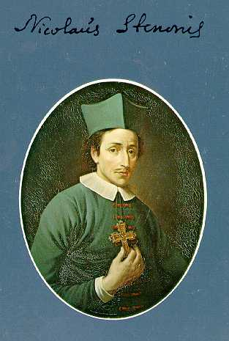
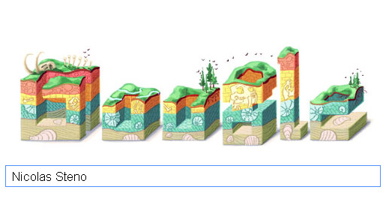
“google doodle” celebrating Steno
(shows geological strata and fossils)
Niels Stensen / Nicolas Steno (1638-86)
one of the founders of geology
(the theory of sedimentary rock and fossils)

Slide 20
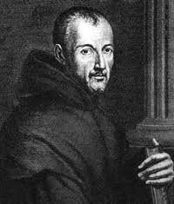
Marin Mersenne (1588-1648)
one of the founders of acoustics
one of the “architects of the
European scientific community”

Slide 21
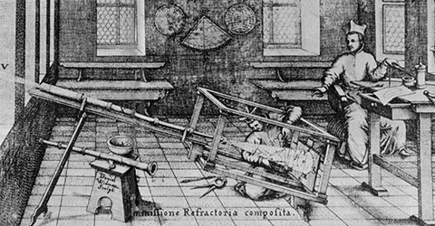
Christoph Scheiner (1573-1650)
one of the discoverers of sunspots

Slide 22
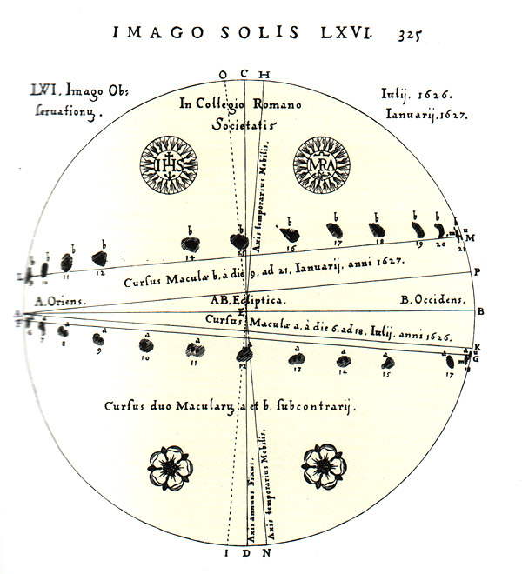

Slide 23
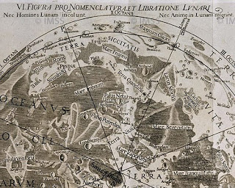
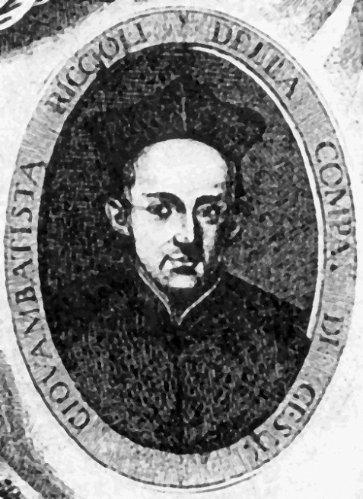
Giovanni Battista Riccioli
(1598-1671)
Extensive star catalogue
Mapped moon’s surface
Accurate measurements of time
First accurate measurement of g
Discovered Coriolis Effect
Riccioli & Grimaldi’s map of the moon

Slide 24
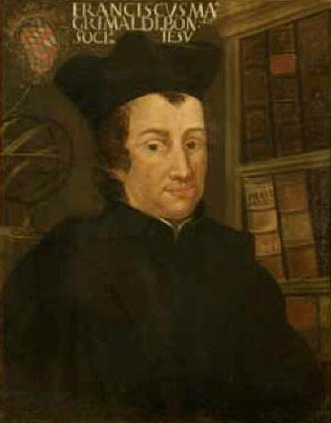
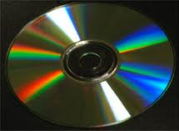
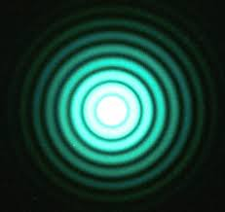
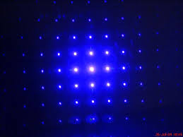
Examples of diffraction:
Francesco Grimaldi (1618-1663)
Discoverer of the diffraction of light

Slide 25
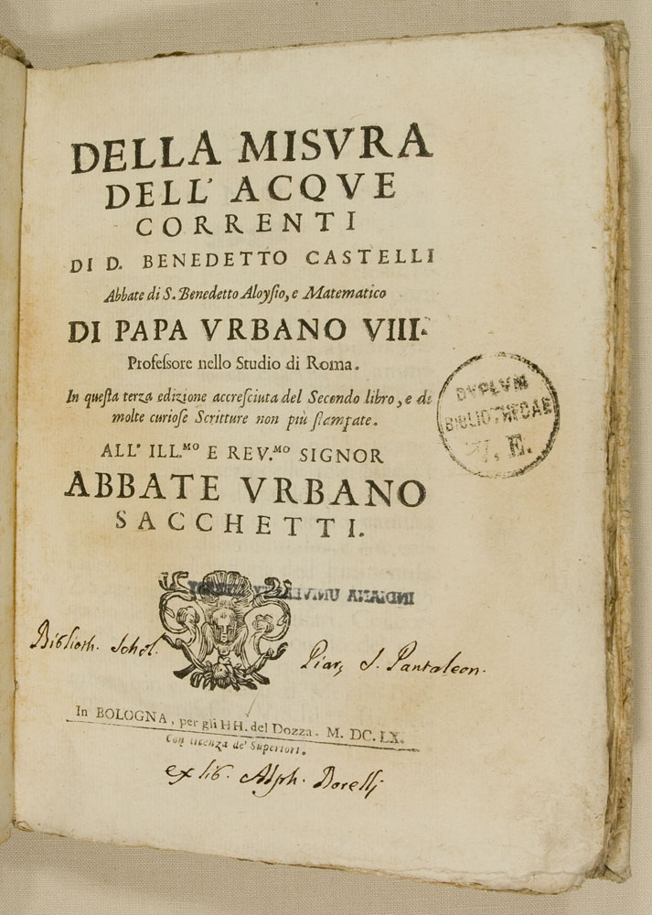
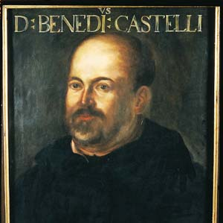
Benedetto Castelli (1578-1643)
founder of hydraulics

Slide 26
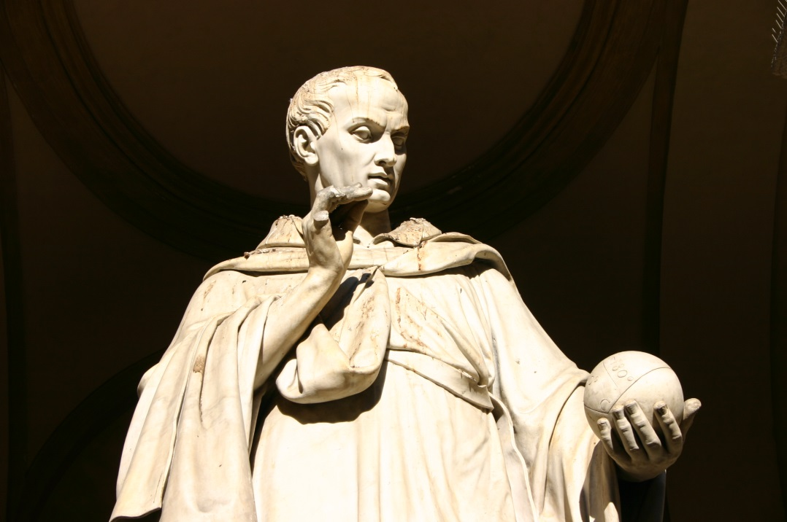
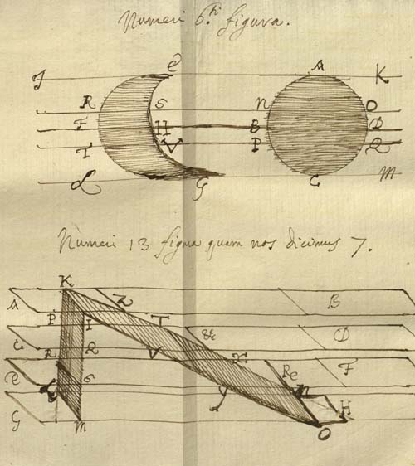
Buonoventura Cavalieri (1598-1647)
Contributed to development of calculus
“In the sublimest of geometry, the initiators and promoters, who performed a yeoman’s task, were Cavalieri and Torricelli. Later others progressed even further, using their work.” --- Leibniz

Slide 27
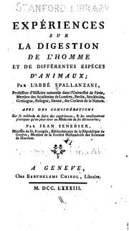
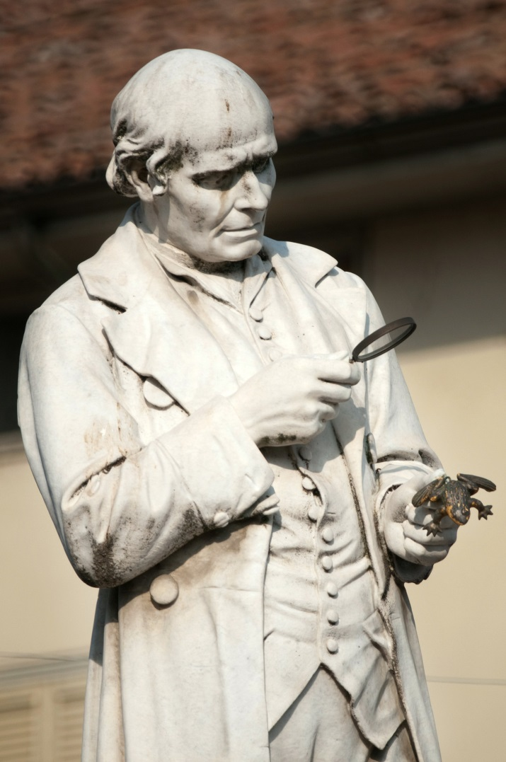
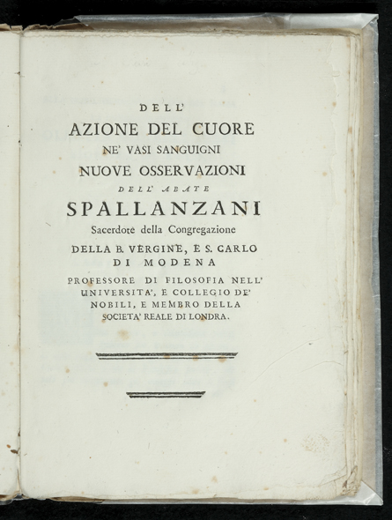
Lazzaro Spallanzani (1729-1799)
a leading 18th century biologist

Slide 28
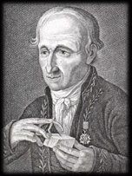
René-Just Haüy (1743-1822)
founder of crystallography

Slide 29

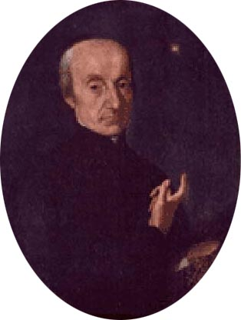
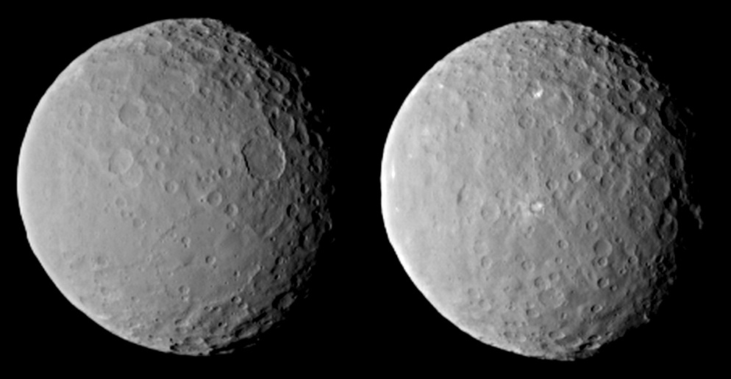
(Hubble Space Telescope)
Giuseppe Piazzi (1746-1826)
Discoverer of Ceres, the first
dwarf planet
(Dawn spacecraft)

Slide 30
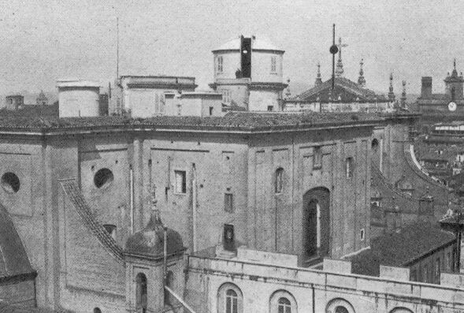
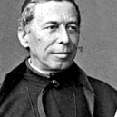
Secchi’s observatory on roof
of Sant’Ignazio Church
Angelo Secchi (1818-1878)
one of the founders of astrophysics
pioneered the spectroscopic study of stars

Slide 31
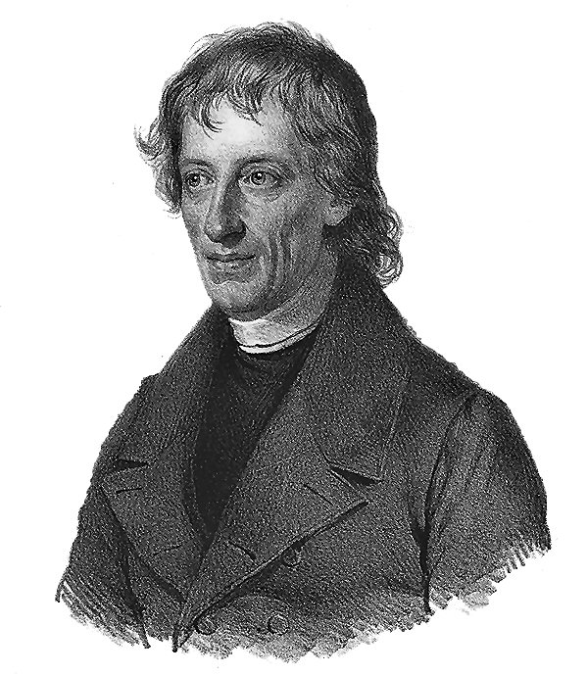
Bernhard Bolzano (1781-1848)
“an outstanding mathematician and
[possibly] the greatest logician … in the time between Leibniz and Frege.”
--- Stanford Encyclopedia of Philosophy

Slide 32
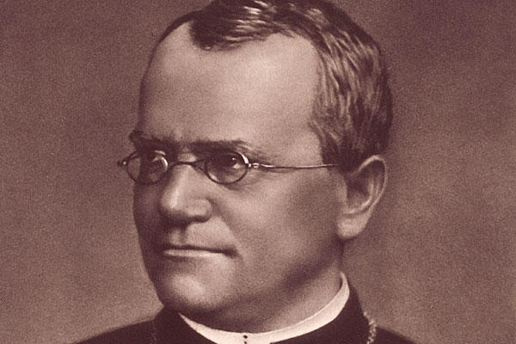
Gregor Mendel (1822-1884)
Founder of genetics

Slide 33
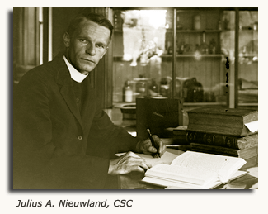
Julius Nieuwland CSC
(1878-1936)
Co-discoverer of neoprene, the first synthetic rubber

Slide 34
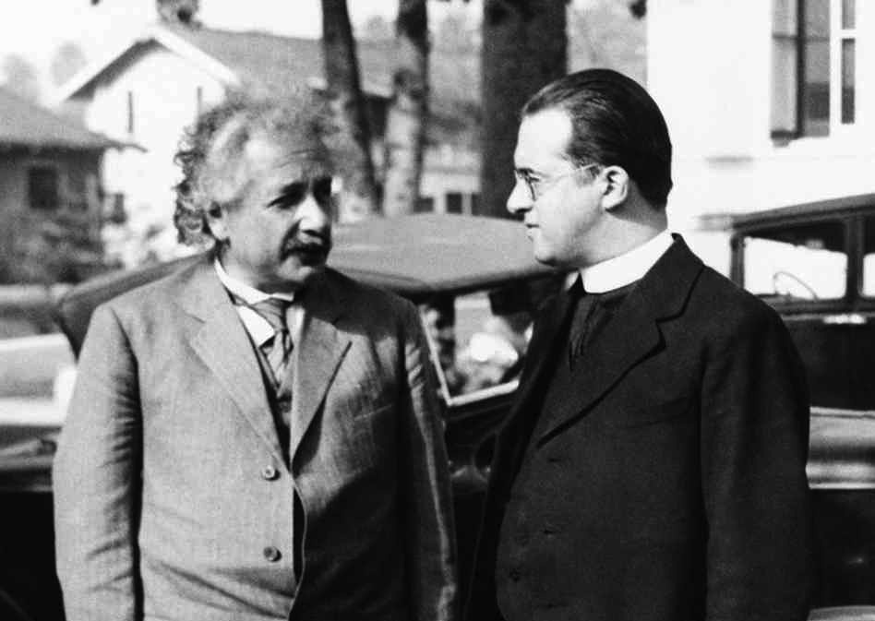
Georges Lemaître (1894-1966)
Founder of the Big Bang Theory

Slide 35
Science and Religion: The Myth of Conflict

Slide 36
“Many people think that modern science is far removed from God. I find, on the contrary, that it is much more difficult today for the knowing person to approach God from history, from the spiritual side of the world, and from morals; for there we encounter the suffering and evil in the world, which it is difficult to bring into harmony with an all-merciful and almighty God. In this domain we have evidently not yet succeeded in raising the veil with which our human nature covers the essence of things. But in our knowledge of physical nature we have penetrated so far that we can obtain a vision of the flawless harmony which is conformity with sublime reason.” --- Hermann Weyl (1932)

Slide 37
“The premise that you can describe in terms of physics the whole function of a human being,… including its knowledge and consciousness, is untenable.”
--- Sir Rudolf Peierls
materialism is “inconsistent with present quantum mechanics”
--- Eugene P. Wigner
“In the case of quantum mechanics, if one presupposes physicalism [i.e. everything is physical], then one quickly lands in the measurement problem.”
--- Hans Halvorson

Slide 38
Science and Religion: The Myth of Conflict

